Slide 1

Tools to use for effective online learning and how to make the most of Moodle

Slide 2
A Slice of Pie
Communication
Collaboration
Acquisition
Student Feedback
Formative Assessment
Summative Assessment

Slide 3
Communication

Slide 4





Cool Communication Choices
Forum
Structured discussions
Chat
Open debates
Group Messaging
Focused topics

Slide 5
Collaboration

Slide 6



Creative Collaboration Channels
Glossary
Student curated content
Database
Structured data collection
Wiki
Collaborative Resource Creation

Slide 7
Acquisition

Slide 8


Awesome Acquisition Approaches
Book
Collection of Web Pages
Database
Structured Content Galleries
Files
Office Documents and Media

Slide 9
Student Feedback

Slide 10



Facilitating Focused Feedback
Choice
Personal Selection
Feedback
Research Surveys
Survey
Pre-made Course Feedback Method

Slide 11
Formative Assessment

Slide 12


Formative Activities / Assessment
Forum
Open discussions
Quiz
Knowledge checks
Lesson
Scenario Based Learning

Slide 13
Summative Assessment

Slide 14


Some Summative Assessment
Quiz
High Stakes Exams
Assignment
Formal Project Work
Workshop
Peer assessment with Rubrics

Slide 15
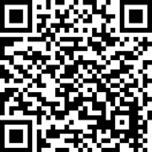
Access Guide Webpage

Slide 16
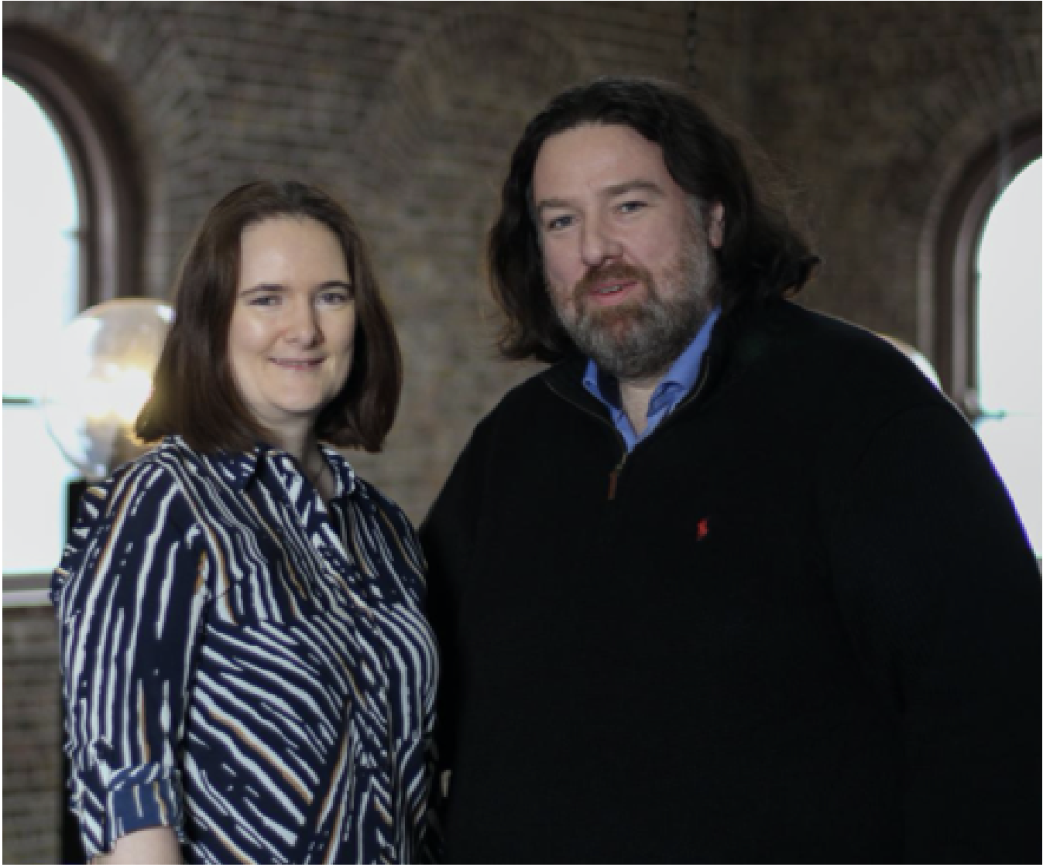





Gavin Henrick
Enhancing the building blocks of effective education
gavin@brickfield.ie
+353 87 640 4000
Brickfield Education Labs
www.brickfield.ie
@ghenrick
Skype: gavin.Henrick

